Slide 1




GRAPH THEORY
PROJECT: Pilgrimage cost Optimization Utilizing Graph Theory.
Presented By:
Gulam Hyder-2202041040
Aditya Devraj Choudhary-2202041041 Harish Chandra Mohanta-2202041042
Ankit Mohapatra-2202041043

Slide 2
Description:
Pilgrimage cost optimization utilizing graph theory is a project aimed at assisting pilgrims in planning their pilgrimage journeys efficiently while minimizing costs. The project focuses on providing a comprehensive platform that helps pilgrims find the most cost-effective routes.
It utilizes advanced algorithms, such as dijkstra's algorithm to calculate the shortest or most cost-effective routes between pilgrimage sites.
It prioritizes routes that minimize travel expenses while ensuring timely arrival at each pilgrimage destination.

Slide 3
PSEUDO CODE:
1. function dijkstra(G, S)
for each vertex V in G distance[V] <- infinite previous[V] <- NULL
If V != S, add V to Priority Queue Q distance[S] <- 0
while Q IS NOT EMPTY
U <- Extract MIN from Q
for each unvisited neighbour V of U
tempDistance <- distance[U] + edge_weight(U, V) if tempDistance < distance[V]
distance[V] <- tempDistance previous[V] <- U
14. return distance[], previous[]
2.
3.
4.
5.
6.
7.
8.
9.
10.
11.
12.
13.

Slide 4
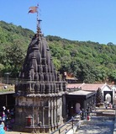

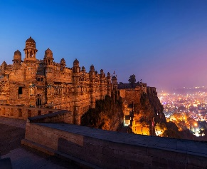




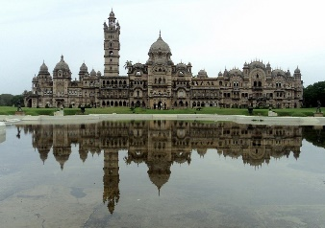
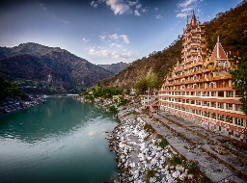

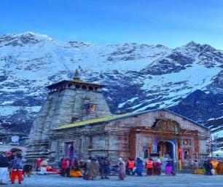

300
Bhimpur
500
500
850
600
500
Nagpur
750
720
150
150
700
Haridwar
Sambalpur
Ambala
450
500
580
630
Vadodora
Rishikesh
500
320
300
Veroval
Kedarnath

Slide 5
POSSIBLE PATHS :
From Sambalpur to Veroval:
Sambalpur → Surat → Veroval(Somnath Temple) :For this route total cost is Rs.930 via train.[MIN COST ROUTE]
Sambalpur → Vadodora → Veroval (Somnath Temple): For this route total cost is Rs.1020 via train.
Sambalpur → Ujjain → Veroval(Somnath Temple): For this route total cost is Rs.1050 via train.
From Sambalpur to Bhimpur(Bhimashankar Temple):
Sambalpur → Nagpur → Pune → Bhimpur: For this route total cost is Rs.1300 via train.
Sambalpur → Ujjain → Pune → Bhimpur: For this route total cost is Rs.1400 via train.
Sambalpur → Pune → Bhimpur: For this route total cost is Rs.1150 via train.[MIN COST ROUTE]
From Sambalpur to Kedarnath Temple:
Sambalpur → Ujjain → Haridwar → Rishikesh → Kedarnath: For this route total cost is Rs.1680 via train.
Sambalpur → Ambala CNT → Rishikesh → Kedarnath: For this route total cost is Rs.920 via train.[MIN COST ROUTE]
Sambalpur → Pune → Ambala CNT → Rishikesh → Kedarnath: For this route total cost is Rs.1800 via train.
From Sambalpur to Ujjain(Mahakaleswar Temple):
Sambalpur →Ujjain : For this route total cost is Rs.600 via train.[MIN COST ROUTE]
Sambalpur→ Pune→ Ujjain : For this route total cost is Rs.1350 via train.
From Sambalpur to Haridwar :
Sambalpur→ Ujjain→ Haridwar : For this route total cost is Rs.1100 via train.
Sambalpur→ Ambala CNT→ Rishikesh→ Haridwar : For this route total cost is Rs.1020 via train.[MIN COST ROUTE]
Sambalpur→ Surat→ Haridwar : For this route total cost is Rs.1210 via train.

Slide 6
OUTPUT :
SOURCE | DESTINATION | OPTIMAL ROUTE | MINIMUM COST
SAMBALPUR | VEROVAL(SOMNATH TEMPLE) | SAMBLPUR→SURAT→VEROVAL | 930
SAMBALPUR | BHIMPUR(BHIMSHANKAR TEMPLE) | SAMBALPUR→PUNE→BHIMPUR | 1150
SAMBALPUR | KEDARNATH | SAMBALPUR→AMBALA CNT→RISHIKESH→KEDARNATH | 920
SAMBALPUR | UJJAIN | SAMBALPUR→UJJAIN | 600
SAMBALPUR | HARIDWAR | SAMBALPUR→AMBALA CNT→RISHIKESH→HARIDWAR | 1020

Slide 7
Thank You

